Slide 1

Twitter API Analysis
Professor: Minh Phan
Student:
Kaveh Jalilian
Financial Europe

Slide 2
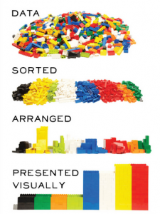
General Primary Steps
Applying for API Keys
CleanData collection
Removing URLs
getting unique elements
Removing stop words
Converting to lower case
Removing collection words
Removing Duplicates, etc.
Creating data frame

Slide 3

Libraries
Tweepy
Pandas
NLTK
NASDAQ stock price

Slide 4



Financial Companies

Slide 5
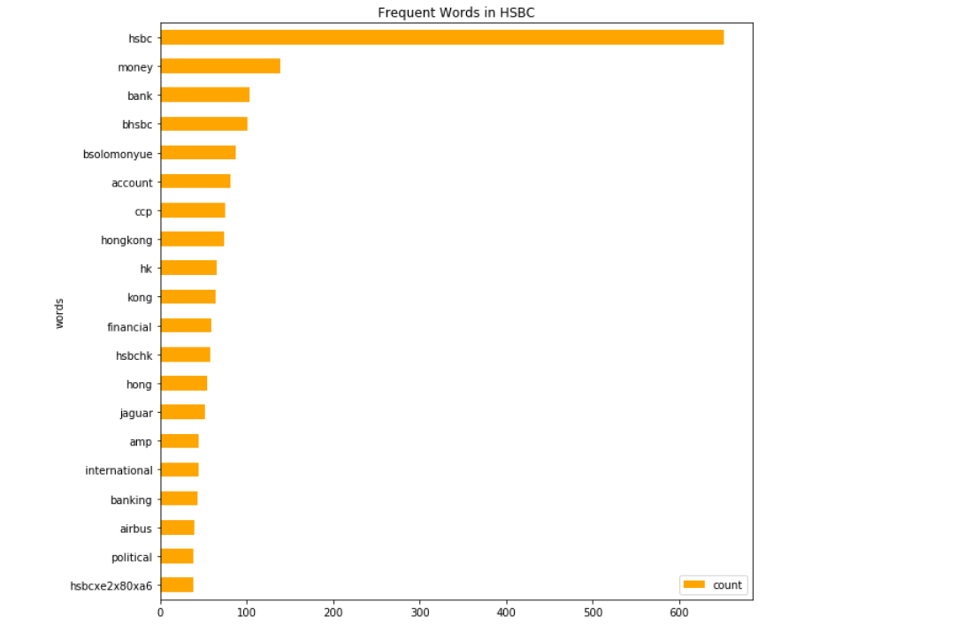
Frequent Words in HSBC

Slide 6
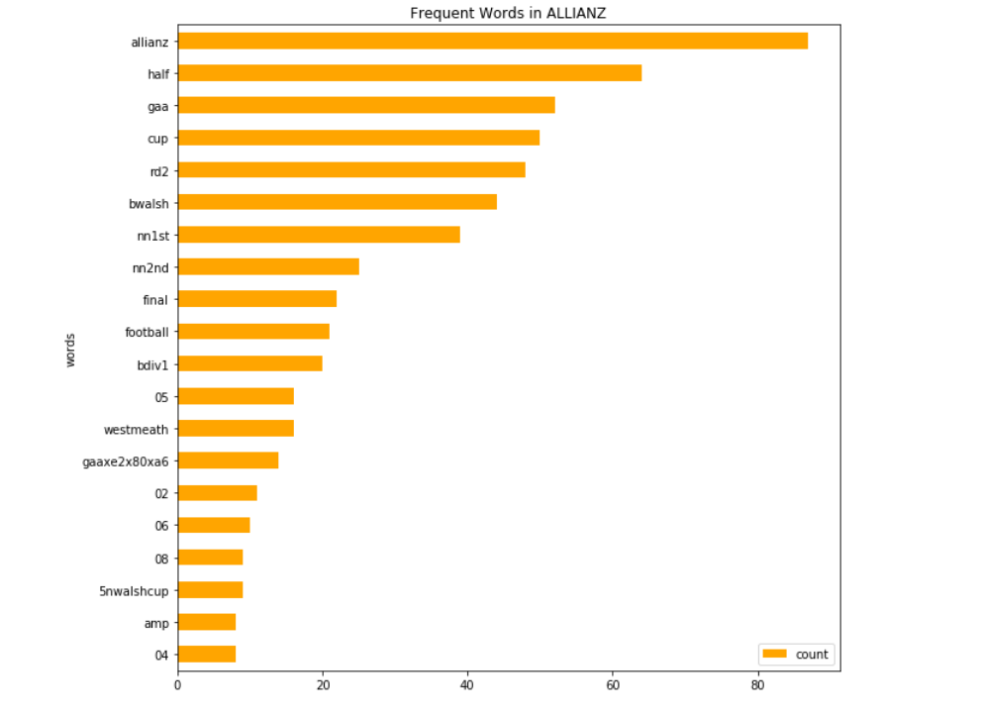
Frequent Words in Allianz

Slide 7
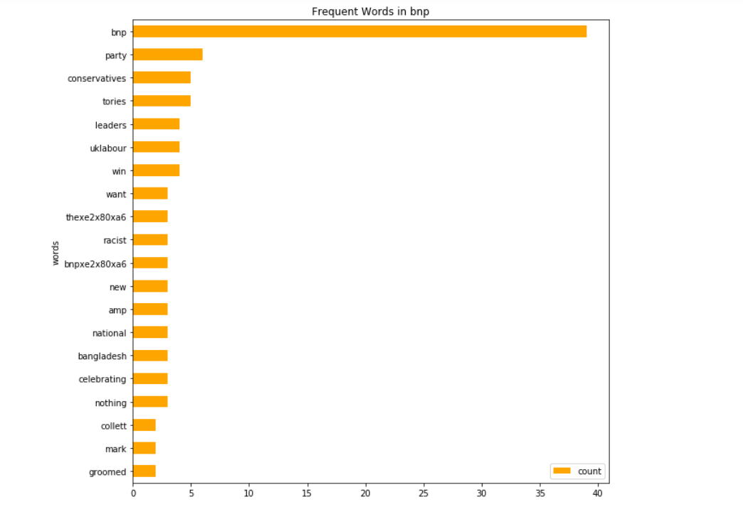
Frequent Words in BNP

Slide 8
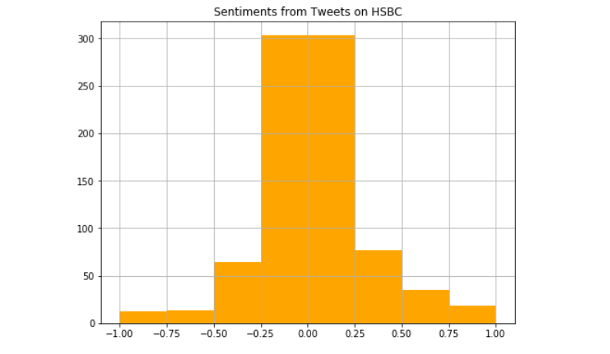
Sentiments from Tweets on HSBC

Slide 9
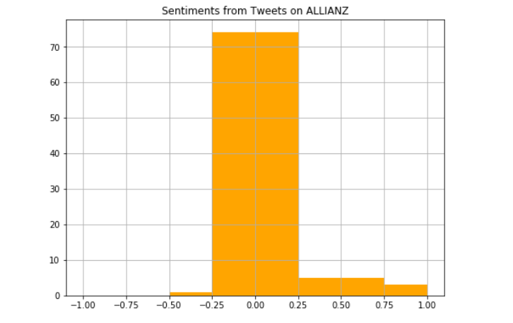
Sentiments from Tweets on Allianz

Slide 10
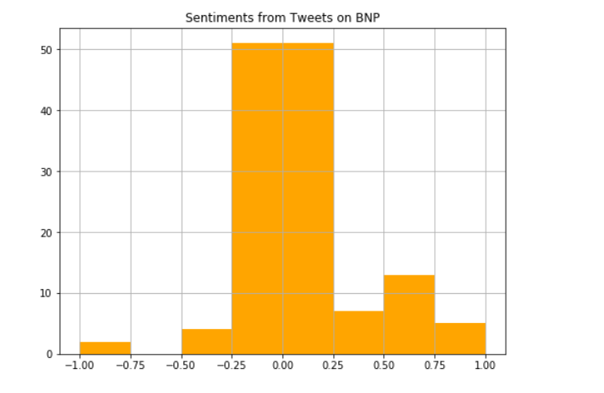
Sentiments from Tweets on BNP

Slide 11
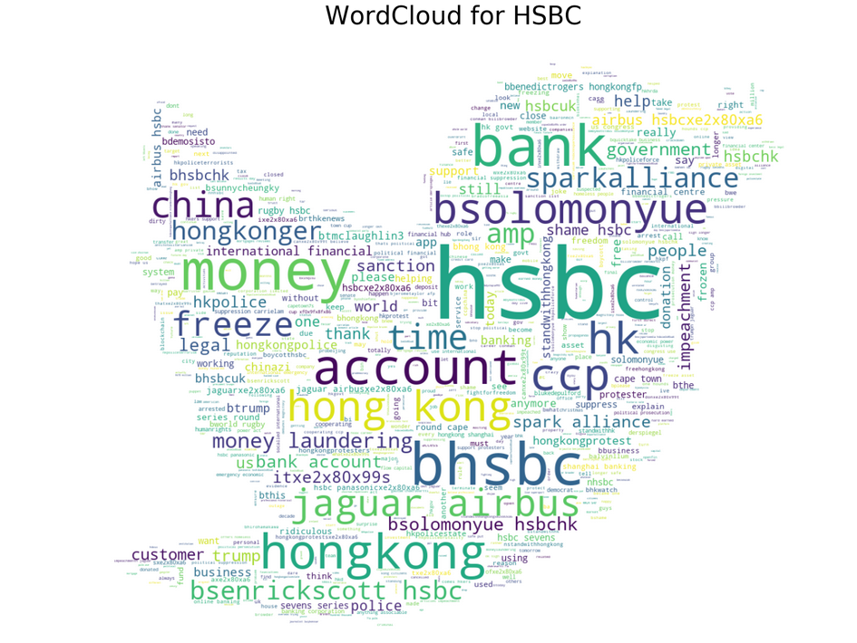
WordCloud for HSBC

Slide 12
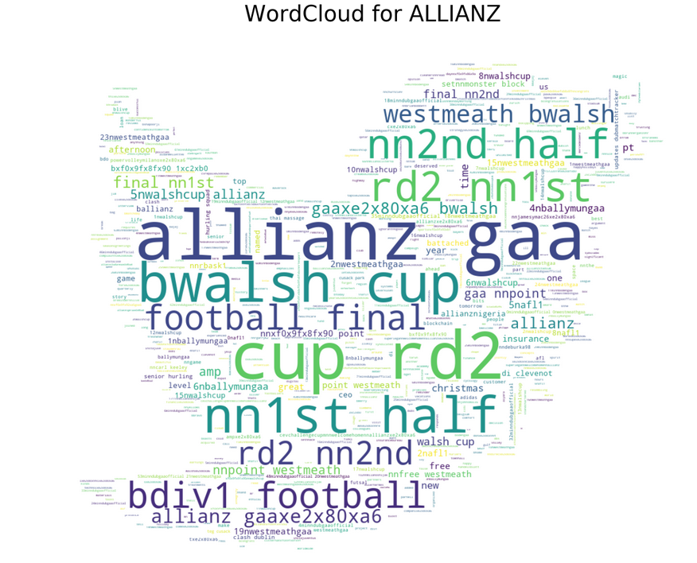
WordCloud for Allianz

Slide 13
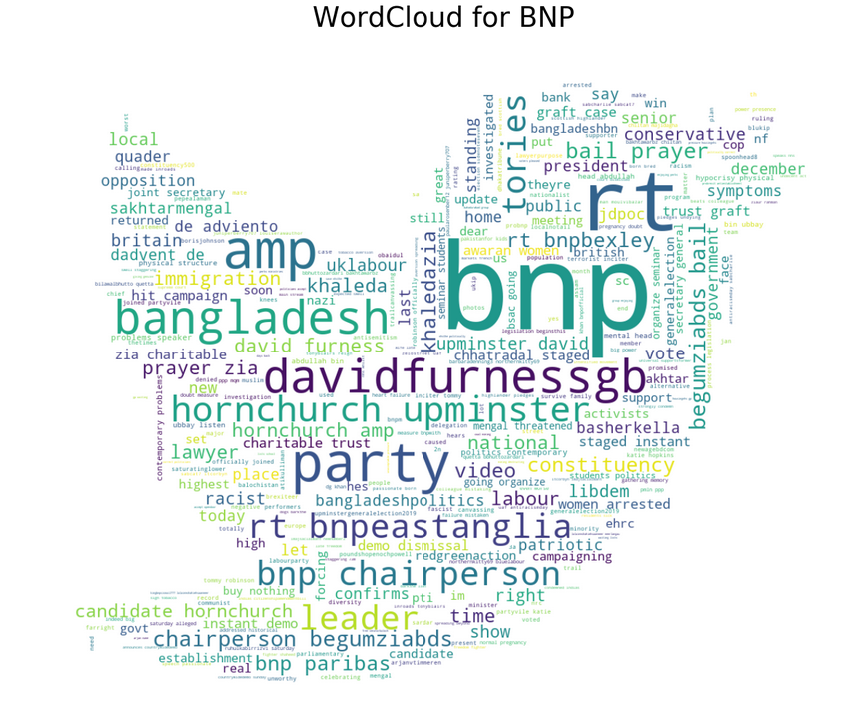
WordCloud for BNP

Slide 14

Conclusions
There’s evidence it affects share prices
A study by Datasift in 2012 showed a big correlation between the sentiment of Twitter users about the Facebook brand and the change in share prices
It gives an insight in to public opinion ( especially users under 37 years old)
You can get information quickly

Slide 15

Merci!
Thanks for your attention

